Slide 1

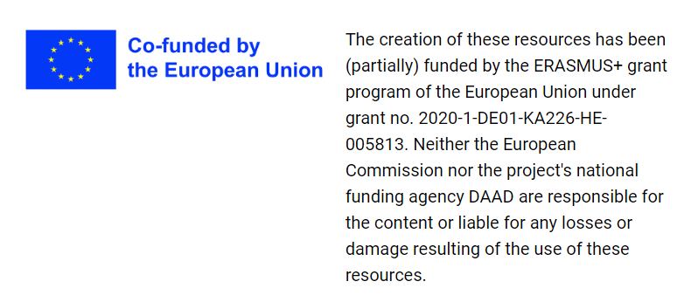





International patient case seminar
Date: 27.01.2023
Bas de Leng, Pauliina Kronqvist, Myrurgia Abdul Hamid, Jack Cleutjens
Partnerships for Digital Education Readiness

Slide 2








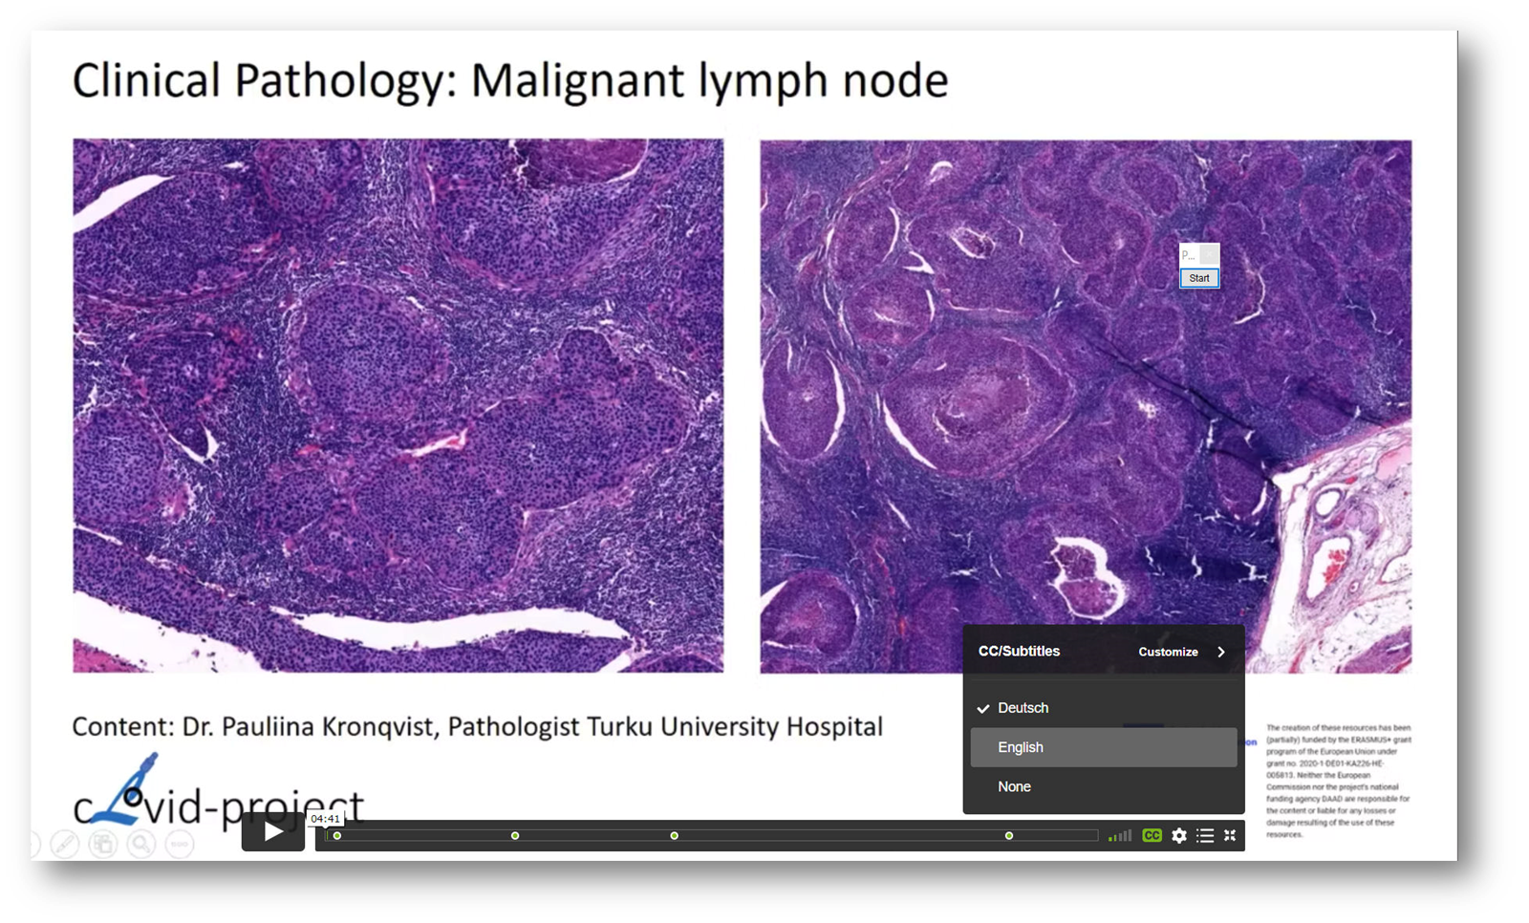
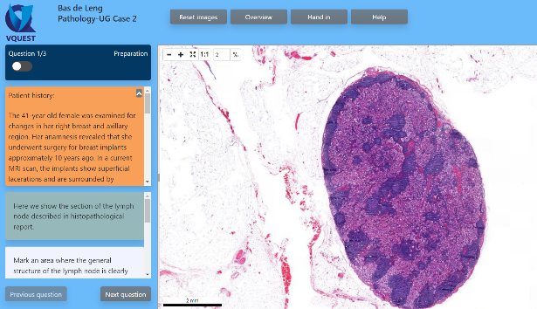
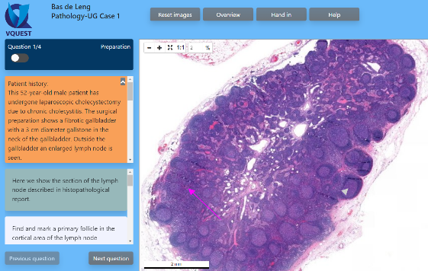
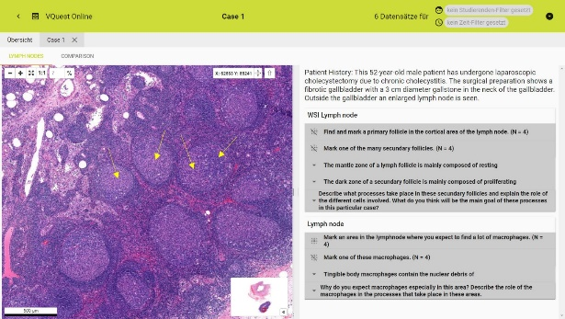
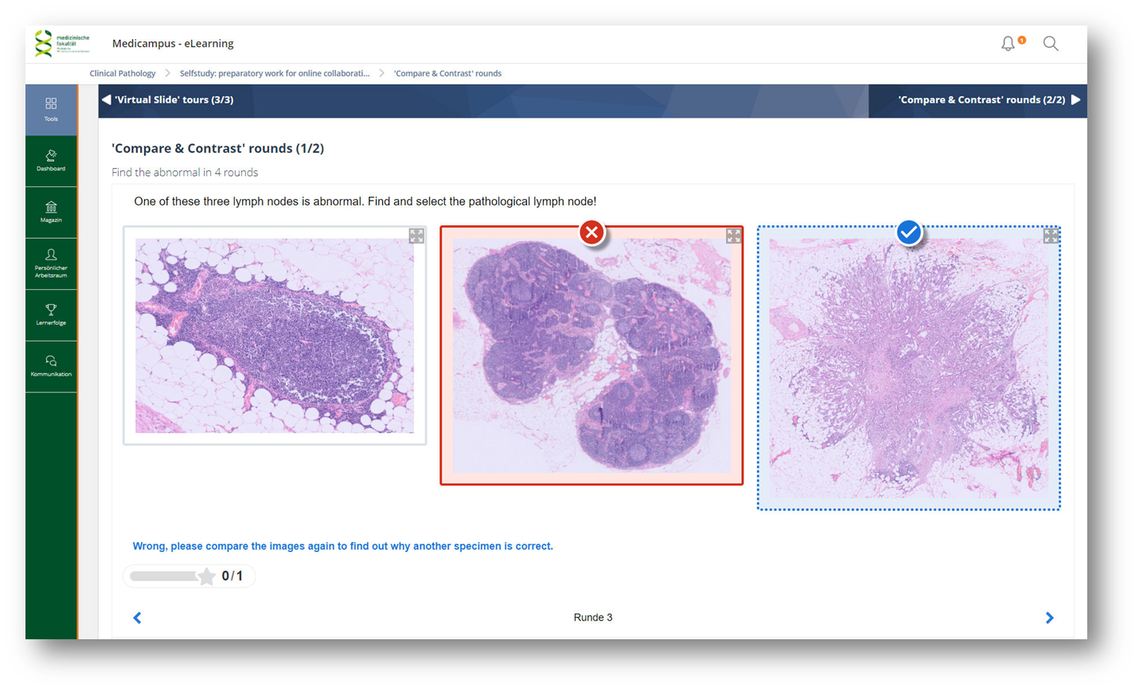
Flipped classroom 'International Patient case Seminar'
❶
❷
Out-of-Class = individual selfstudy
In-Class = collaborative work in online seminar
a)
b)
Intra-team
Inter-team
Video tutorials
VQuest cases
VQuest case
PRISMA learning dashboard
H5P interactive content

Slide 3






Collaborative work: intra-team activities
Part I
TM1
Time allocation:
~ 60 minutes
Microscopy task in VQuest:
6 students
Online with Zoom (breakout rooms)
Group answers
2 supervisors visit the groups
Co-host UTU
M3
T4
VQuest
VQuest
TM6
VQuest
Co-host UM
VQuest

Slide 4


Collaborative work: inter-team activities
Part II
Time allocation:
~ 30 minutes
Plenary debriefing:
78 students; 11 answers
Online with Zoom and PRISMA
Group argumentation
2 supervisors moderate the discussion
Co-host UM
Co-host UTU
Rotation
M1-a
b
c
d
e
f
T1-a
b
c
d
e
f
PRISMA Learning Dashboard
TM1-a
b
c
d
e
f
TM2-a
b
c
d
e
f

