Slide 1

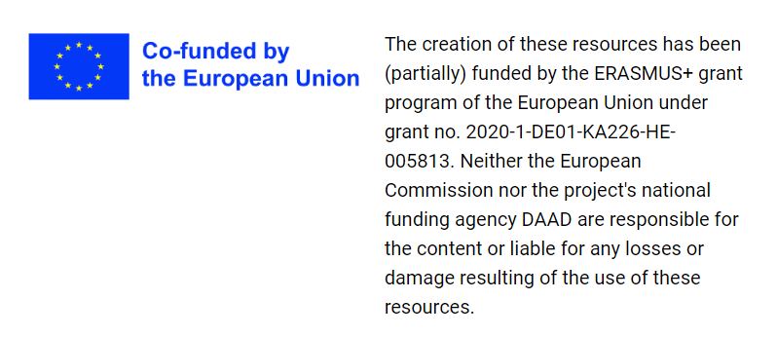





Preparation National Pathology Exam
Date: 13.01.2023
Vesa-Matti Pohjanen, Otto Jokelainen, Bas de Leng
Partnerships for Digital Education Readiness

Slide 2
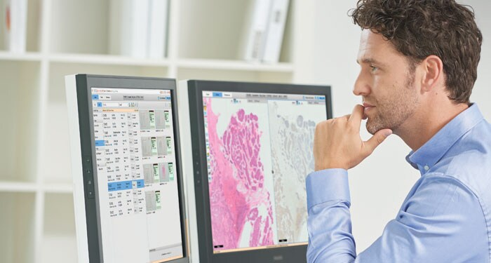







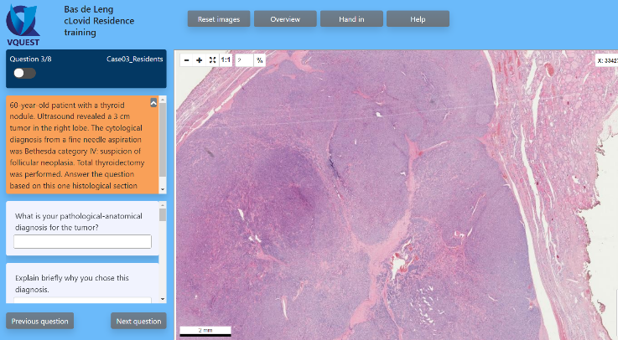
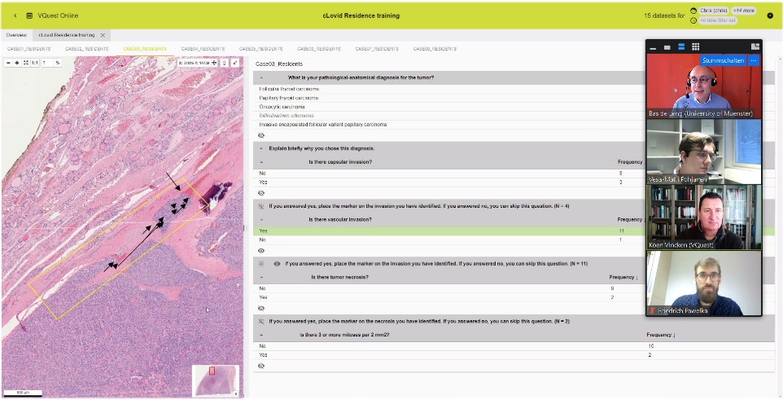
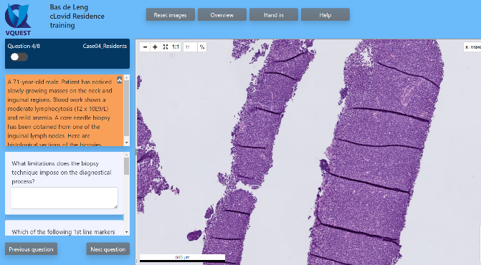
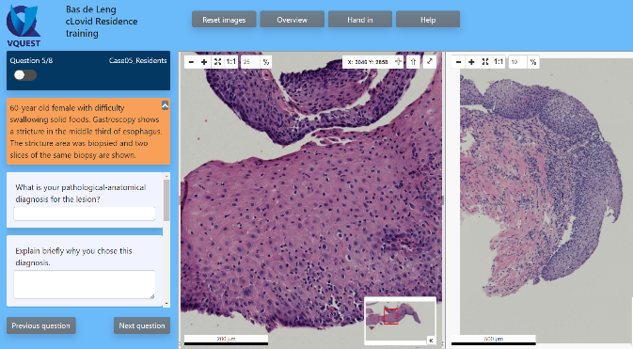
Flipped classroom ' Preparation National Pathology Exam'
❶
❷
Out-of-Class = individual assignment
In-Class = debriefing in online seminar
VQuest cases
PRISMA learning dashboard

Slide 3
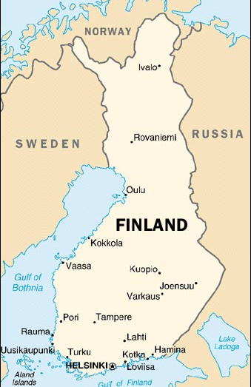
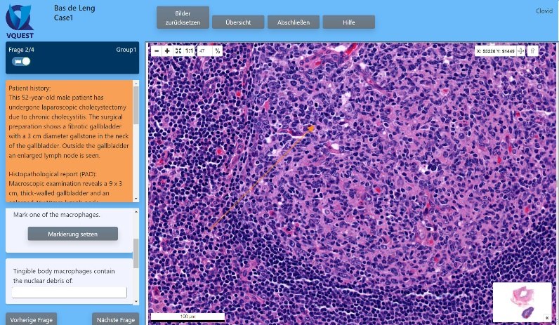




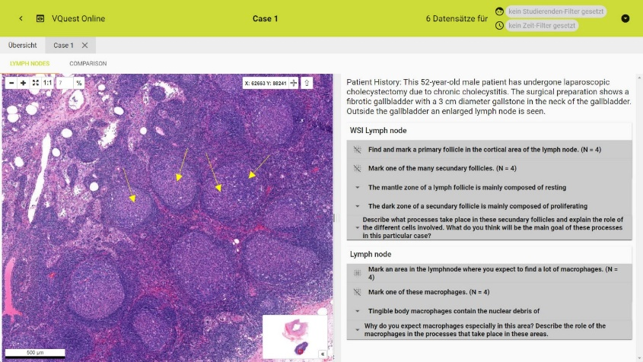


Setting
10-15 residents
various levels of training
working at different hospitals
Online at home
Eight patient cases
VQuest
Individual work (total 3 hours)
wk 50
wk 51
wk 52
wk 1
wk 2
Online debriefing
2x 50 minutes
PRISMA Learning Dashboard

